Slide 1
Parallel Processing
Course Introduction
Ron Coleman, Ph.D.

Slide 2
Syllabus
Availability
Course description
Goals
Texts and materials
Attendance
Academic honesty
Outcomes and assessment
Proposes schedule

Slide 3

Lab assignments
Given a week ahead of due date.
Look under Assignments:
If you have questions, you have three choices:
Best: Ask publically in Piazza (see below).
Better: Ask privately in Piazza.
Ok: Email me.
ronncoleman@gmail.com

Slide 4
Project assignments
Typically given two weeks ahead of due date
Also under Assignments:
If you have questions...same protocol as prior slide.

Slide 5

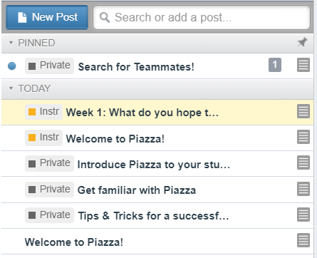
Piazza: 1st week
Piazza in left panel under:
3. Then...click here to respond. See next slide for what to do next.
2. Then...click here to read this.
1. Start here; click to read from Piazza.

Slide 6
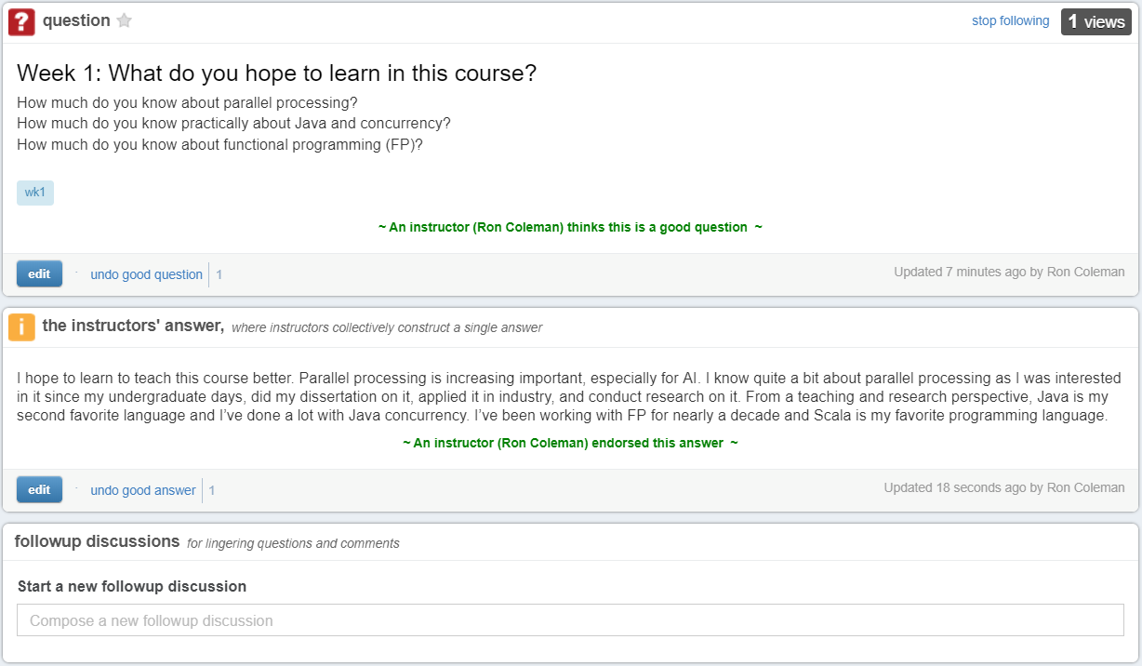
Piazza: Responding
After clicking question, you get this:
Begin typing your reply here.

Slide 7

Piazza: posting your own questions
Need clarification on some point?
Having problems with code? etc.
Feel free to post own question:
Any topic related to course material

Slide 8
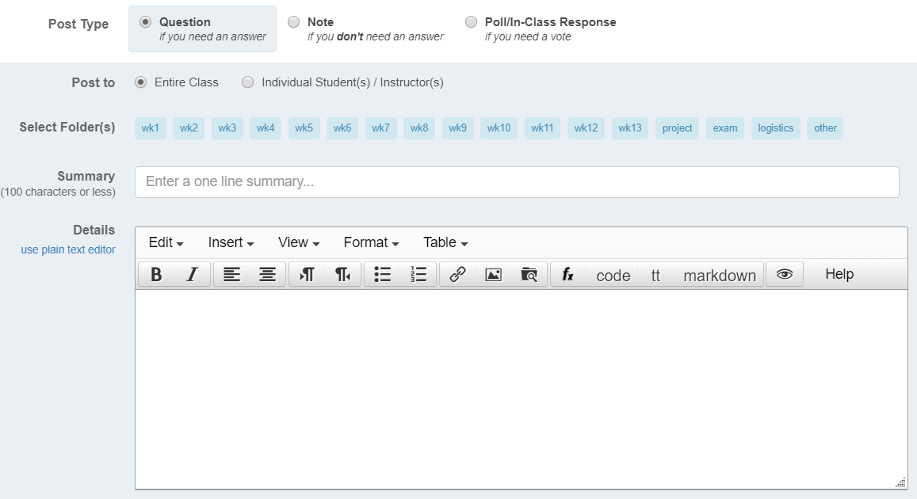
Check this if this is a question.
Select the appropriate category.

Slide 9
How we use Piazza
One question per week from me
Minimum two (2) responses/week from you to:
1. My initial question
2. Another student’s response
Responses must be during week of question.
No credit for late responses

Slide 10
How to write a Piazza post
Reply directly to question.
Employ evidence, reason, argument, etc. -- mere opinions are not sufficient.
Use appropriate language.
Strive for clarity.

Slide 11
Piazza evaluation criteria
Did you contribute minimally or beyond it?
Were your responses on-topic?
How did others rate your interactions?
Did you post questions?

Slide 12
What to do next?
Download & review lecture 679wk01.pptx.
Work on this week’s discussion in Piazza. (See my Week 1 reply as a model.)

